Slide 1
Curve Fitting Variations and Neural Data
Julie Michelman – Carleton College
Jiaqi Li – Lafayette College
Micah Pearce – Texas Tech University
Advisor:
Professor Jeff Liebner – Lafayette College

Slide 2
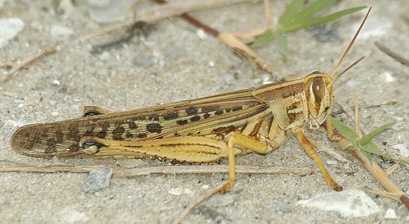
Neurological Statistics
Stimulant
Neurons
Spikes

Slide 3
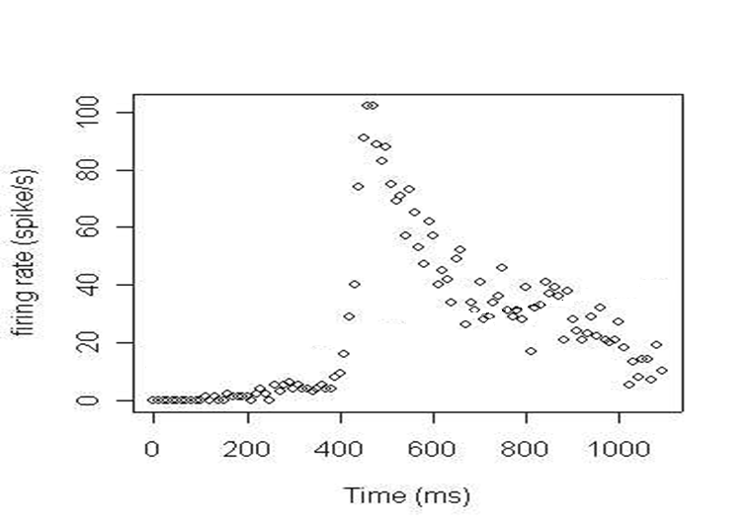
Distribution of Spikes

Slide 4
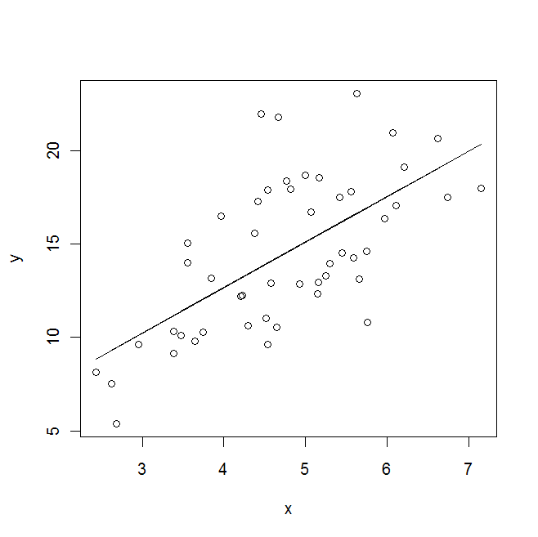
Simple Linear Regression
Y_{i} = β₀ + β₁ x_{i} + ε_{i}
Minimize RSS:

Slide 5
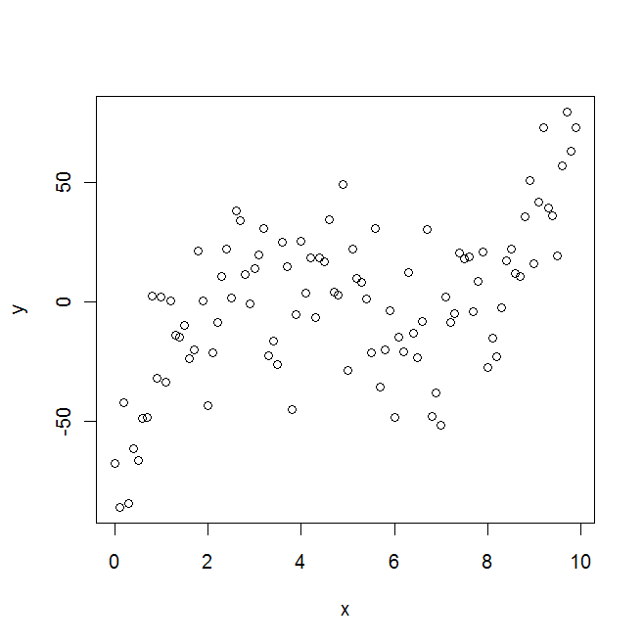
Polynomial Regression

Slide 6
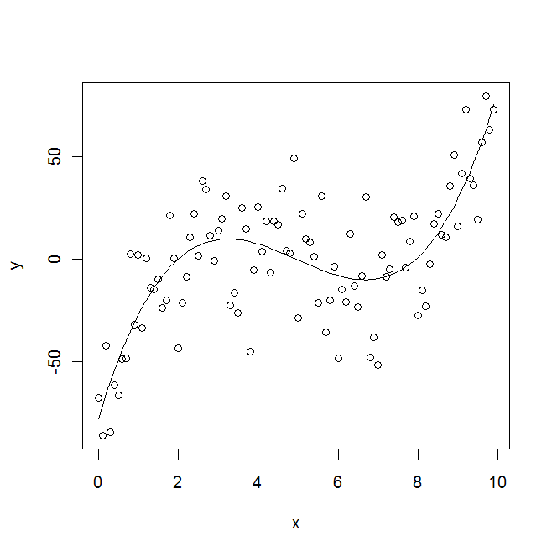
Polynomial Regression
Y_{i} = β₀ + β₁ x_{i} + β₂ x_{i}² + β₃ x_{i}³ + ε_{i}

Slide 7
Our Data

Slide 8
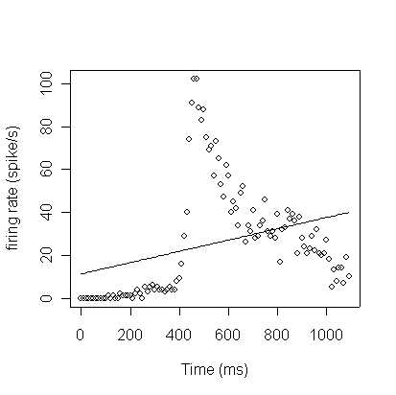
Linear Fit

Slide 9
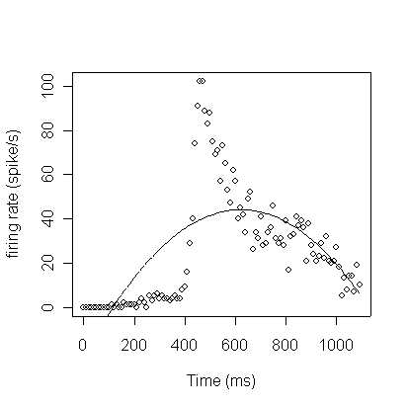
Quadratic Fit

Slide 10
Cubic Fit

Slide 11
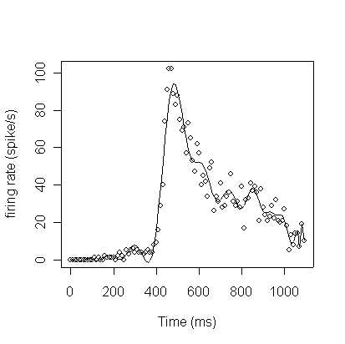
34-Degree Polynomial Fit

Slide 12
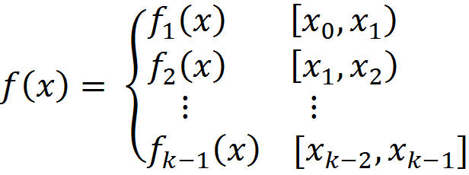
An Alternative: Splines
Spline: piecewise function made of cubic polynomials
Partitioned at knots
Evenly spaced … or not

Slide 13
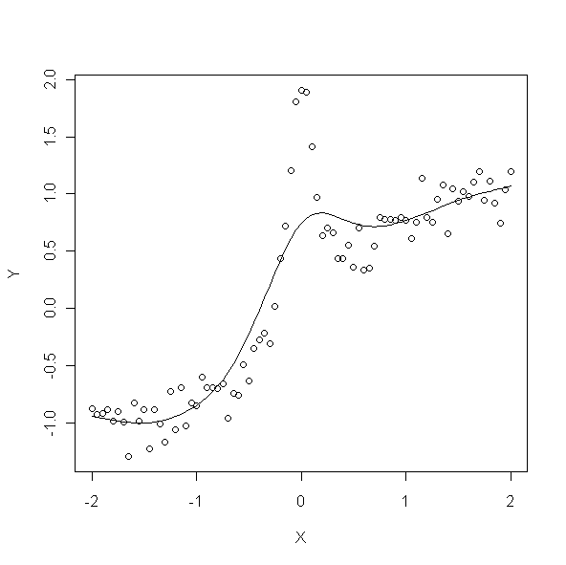
Spline - Underfit

Slide 14
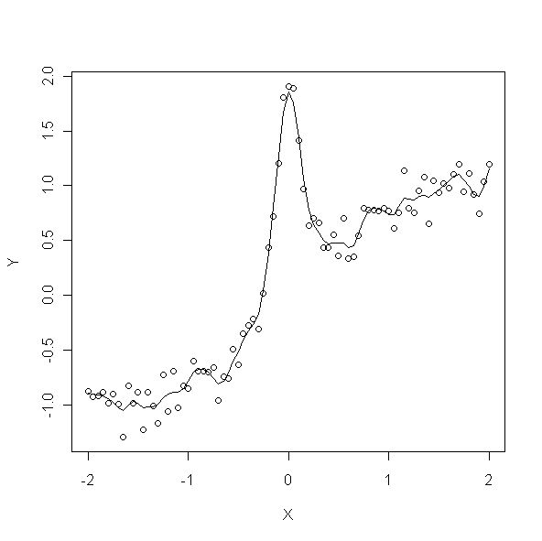
Spline - Overfit

Slide 15
Balancing Fit and Smoothness
Two alternative solutions
Regression Splines
Use only a few knots
Question: How many knots and where?
Smoothing Splines
Penalty for overfitting
Question: How much of a penalty?

Slide 16
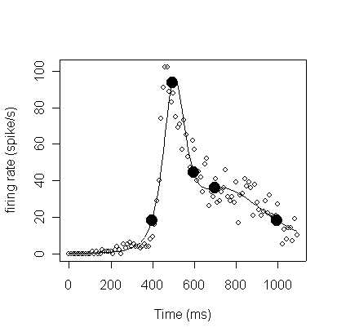
Regression Splines
Select a few knot locations
Often chosen by hand, or evenly spaced

Slide 17
BARS - Bayesian Adaptive Regression Splines
Goal:
Find best set of knots
Method:
Start with a set of knots
Propose a small modification
Accept or reject new knots
Repeat using updated knots
Compute posterior mean fit
Go to R for demo …

Slide 18
Smoothing Splines
Best fit minimizes PSS
1st term
distance between data and fitted function
2nd term
penalty for high curvature
λ
weight of penalty

Slide 19
Large λ – Smoother Fit
Good on sides, underfits peak

Slide 20
Small λ – More Wiggly Fit
Captures peak, overfits sides

Slide 21
Smoothing Spline with Adjustable λ
Given λ, best fit minimizes PSS
But what is best λ, or best λ(x)?

Slide 22
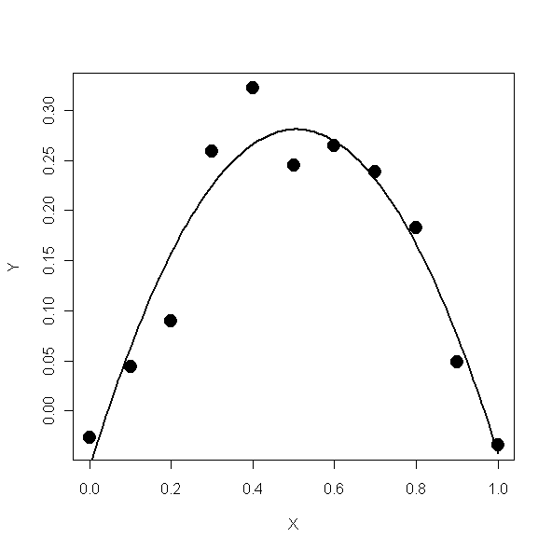
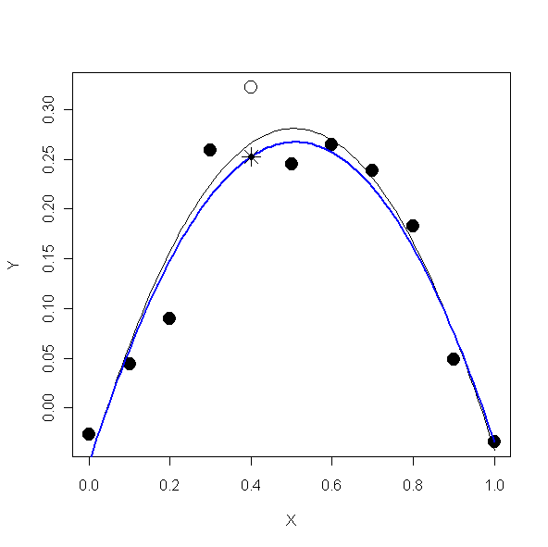
Cross Validation (CV)
Goal: minimize CV score
blue – f _{– i} (x)

Slide 23
Cross Validation
Ordinary smoothing splines:
Define “best” λ as minimizing CV score
Our solution:
Define “best” λ (x) at x_{i} as minimizing CV score near x_{i}
Combine local λ’s into λ(x)

Slide 24
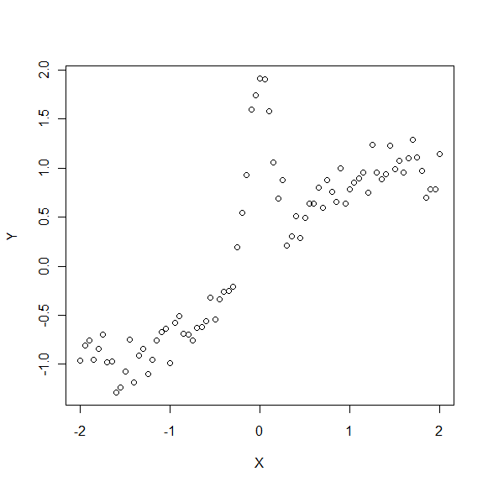
Local Lambda– A graphic illustration

Slide 25
Local Lambda– A graphic illustration
Window size
bandwidth = 31 points

Slide 26
Local Lambda– A graphic illustration
Lambda chosen by
cross validation

Slide 27
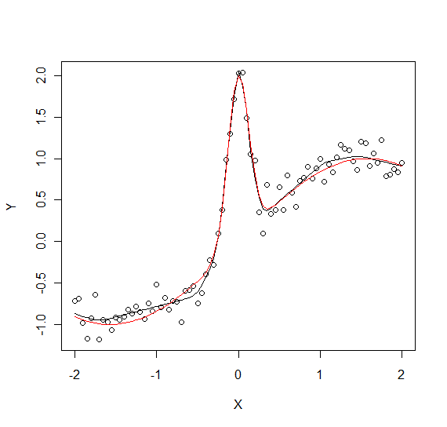
Local Lambda– A graphic illustration
Key
Red -
True Function
Black -
Local Lambda Fit

Slide 28
Showdown!!
Local Lambda Method
Versus
Regular Smoothing Spline

Slide 29
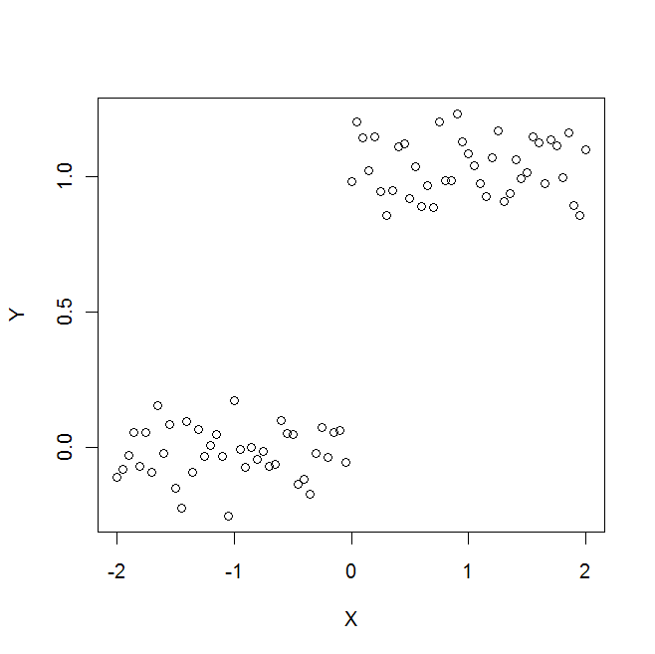
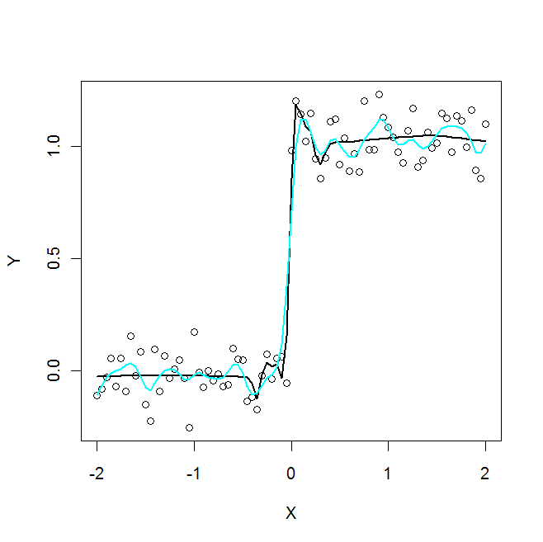
Step Function
Key
Blue -
Constant Lambda
Black -
Local Lambda Fit

Slide 30
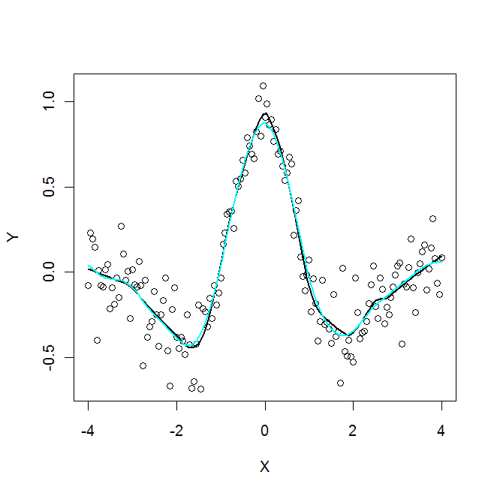
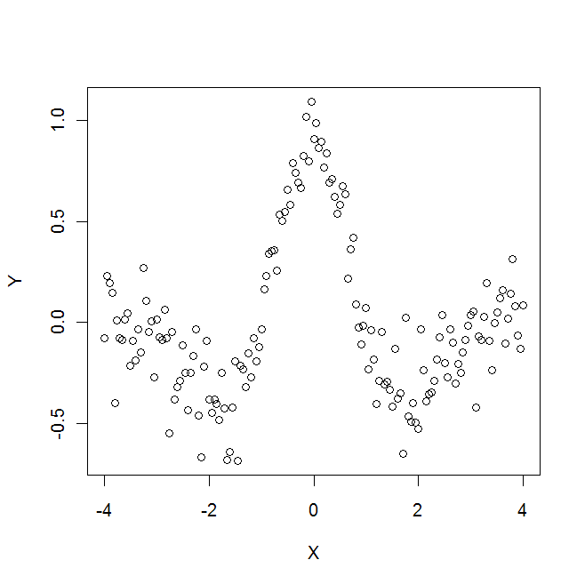
Mexican Hat Function
Key
Blue -
Constant Lambda
Black -
Local Lambda Fit

Slide 31
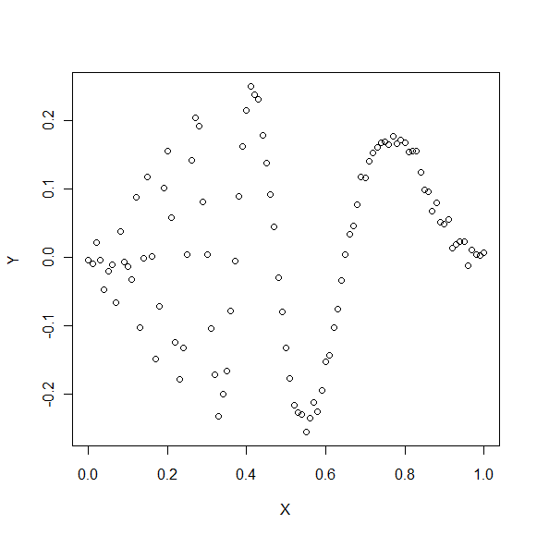
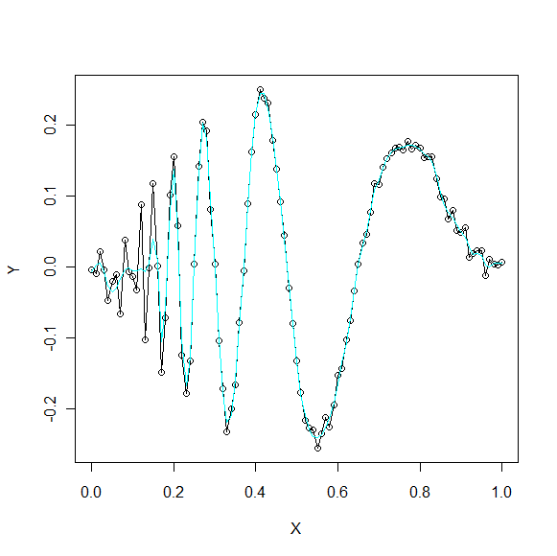
Doppler’s Function
Key
Blue -
Constant Lambda
Black -
Local Lambda Fit

Slide 32
Conclusions
Highly variable curvature:
Local Lambda beats regular smoothing spline
More consistent curvature:
Regular smoothing spline as good or better
Final Assessment:
Local Lamba Method is successful! – It is a variation of smoothing spline for that works for highly variable curvature.

Slide 33
Thank You
Thanks to
Gary Gordon for running the Lafayette College Math REU
The National Science Foundation for providing funding
Our advisors Jeff Liebner, Liz McMahon, and Garth Isaak for their support and guidance this summer
Carleton and St. Olaf Colleges for hosting NUMS 2010
All of you for coming to this presentation!

