Slide 1
A method for combining family-based rare variant tests of association
Kaitlyn Cook
Carleton College
Northfield Undergraduate Mathematics Symposium
October 7, 2014

Slide 2
An Introduction to Genetics
Genetic information stored in DNA
Coded as a sequence of Adenines, Thymines, Guanines, and Cytosines
Organized into chromosomes
Gene…a collection of nucleotides
Allele…a version of a gene
Gene 1
Gene 2
A A T C G G A T T C T G G A C C C C G C G C G A T T
A A T C G G A T T C T G G A C A C C T C G C G A T T

Slide 3
An Introduction to Genetics
Genetic information stored in DNA
Coded as a sequence of Adenines, Thymines, Guanines, and Cytosines
Organized into chromosomes
Homozygous…having two copies of the same allele
Heterozygous…having copies of two different alleles
Homozygous
Heterozygous
A A T C G G A T T C T G G A C C C C G C G C G A T T
A A T C G G A T T C T G G A C A C C T C G C G A T T

Slide 4
An Introduction to Genetics
Genetic information stored in DNA
Coded as a sequence of Adenines, Thymines, Guanines, and Cytosines
Organized into chromosomes
Single Nucleotide Polymorphism (SNP)
Minor allele
Single Nucleotide Variant (SNV)
A A T C G G A T T C T G G A C C C C G C G C G A T T
A A T C G G A T T C T G G A C A C C T C G C G A T T
Notes:
Single Nucleotide Polymorphism (SNP)…DNA sequence variation where just one nucleotide differs between individuals in a population
Minor allele…the SNP with a smaller population frequency
Single Nucleotide Variant (SNV)…SNP with minor allele frequency less than 5%

Slide 5
Rare variants
Possible that these rare variants are associated with complex diseases
Either risk-increasing or risk-reducing
Want to be able to detect these sorts of associations
One problem: POWER
Two solutions:
Gene-based tests of association
Use family-based study designs

Slide 6
Gene-based association tests
Rather than analyzing individual SNVs, we can collapse them on a gene level
Instead of testing whether one SNV is associated with a disease phenotype, we test whether at least one SNV in a given gene is associated
Aggregates the signal and increases power
Two ways of collapsing
Burden tests
Variance component tests

Slide 7
Gene-based association tests
Tests perform optimally in different circumstances
Burden tests: all the SNVs are risk-increasing or risk-reducing
Variance component tests: mixture of risk-increasing or risk-reducing
Power depends on type of test and genetic architecture
Drawback: picking the “right” test requires knowing genetic architecture beforehand
Picking the “wrong” test could lead to substantial drop in power

Slide 8
Family-based study design
Recruit families into the study
Genotype all possible members of each family
Construct pedigrees
Genetic inheritance means that rare variants are aggregated in the families
Increased prevalence means increased power

Slide 9
Our focus
If different tests perform better under different scenarios, can we somehow combine information from these tests to improve power?
Develop a flexible method that:
Can combine any number and type of family-based tests of association
Increase statistical power and robustness
Maintains type I error

Slide 10
Combination method
Generate a vector of test statistics, Q(0) = (Q₁,…, Q_{k})
Permute the phenotype m times, finding Q(1), …, Q(m)
Convert test statistic vectors Q(i) into p-value vectors p(i) by determining each test statistic’s relative rank among the m permutations
Combine p-values within each permutation into a single summary statistic S(i)
Compute the significance level of S(0) by finding the percentage of S(i) which are greater than S(0), out of m.

Slide 11
Permutation strategy
Typical permutation approaches do not work in family setting
Fit the data to a random effects model
Fixed effects for covariates
Random effects for kinship
Permuted the residuals

Slide 12
Data used
Genetic Analysis Workshop 19
Human sequence data
Sequence information for 959 individuals in 20 families
Phenotype of interest: Systolic and diastolic blood pressure
Real and simulated phenotypes provided
200 replicates of the simulated phenotype
Used to calculate power/type I error

Slide 13
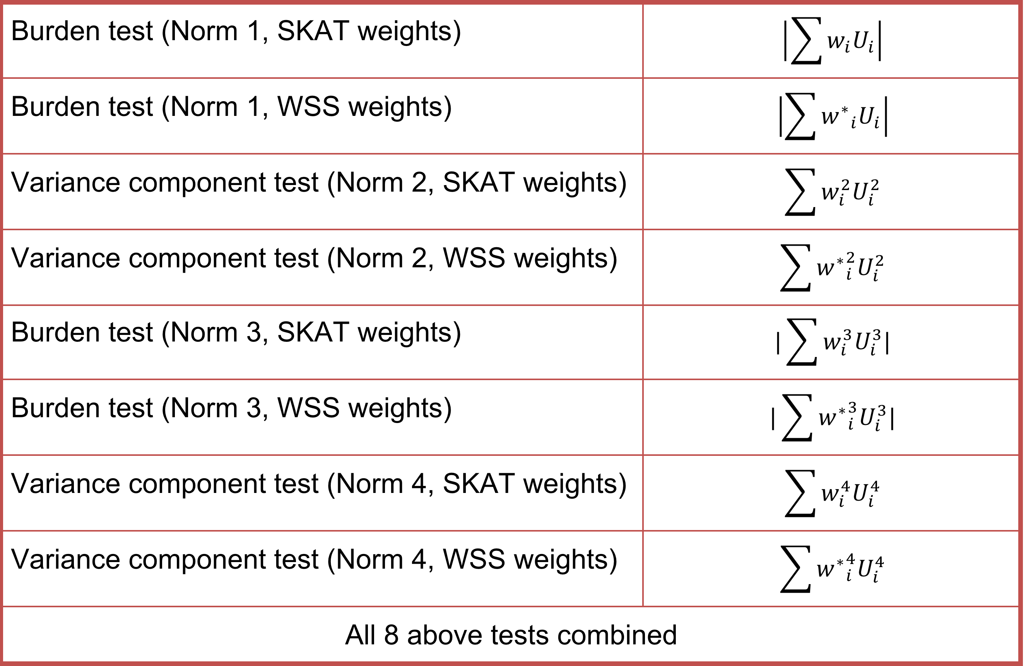
Statistical tests used

Slide 14
Results
Type I error conserved across both individual and combined family-based tests
Power was generally low for all tests used
Combined test had empirical power in the same range as the individual tests
Choice of variant weighting system had substantial impact on empirical power
Combined test more robust to differences in the characteristics of individual genes

Slide 15
results
Warm colors: SKAT weights
Cool colors: WSS weights
Black: combined test approach

Slide 16
Next steps
Working to determine the optimal type or number of tests to include in the combined test statistic
Reducing correlation between the tests being combined
Incorporation of further biological information into the test statistic

Slide 17
Acknowledgements & References
NIH/NHGRI: R15HG006915
NSF/MCB: 1330813
Derkach A, Lawless J, Sun L (2012) Robust and Powerful Tests of Rare Variants Using Fisher’s Method to Combine Evidence of Association From Two or More Complementary Tests. Genet Epidemiol 00:1-12.
Greco B, Hainline A, Liu K, Zawistowski M, Tintle N General approaches for combining multiple rare variant association tests provide improved power across a wider range of genetic architecture (in progress)

