Slide 1
Evaluating an Adaptive Clinical Trial with Quantitative Endpoints, Sample Size Re-estimation, Sequential Monitoring for Efficacy, and Monitoring for Futility
By: Harrison Reeder
Mentor: Dr. Kathryn Chaloner
Iowa Summer Institute in Biostatistics

Slide 2
Outline
What exactly does that title mean?
Basic Clinical Trial design
Interim Monitoring for Efficacy
3 schemes for interim monitoring for efficacy
Interim monitoring for futility
Adaptive sample size re-estimation
Simulation Study of Design Performance
Conclusion
Notes:
KP
The title describes a novel clinical trial design with several key features, so I will describe those, and present the results of the study we performed to test their utility. We will end by concluding whether this design is an improvement over a simpler traditional design.

Slide 3
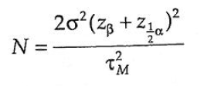
Clinical Trial Design: The Basic Case
The most basic element of clinical trial design is determining an adequate sample size
Calculating sample size requires specifying:
approximate variance of outcomes
the desired Type I error rate
minimum clinically meaningful treatment effect
desired power to detect that effect
Code in R: power.t.test()
Taken from Introduction to Randomized Controlled Clinical Trials by John Matthews
Notes:
Kamrine Elisa Poels
Type I error: rejecting null when null is true (finding an effect when there is no effect)
Power: probability of rejecting null given some alternative is true

Slide 4
Motivating Clinical Trial Example
Treatment of insomnia in children with autism
Phase II Clinical Trial
Only previous study was small and on adult subjects
In general, poor understanding of responses motivates need for adaptive trial
Better performance with incorrect estimates?

Slide 5
Interim Monitoring for Efficacy
Why use interim monitoring?
Complications of interim monitoring
Interim monitoring inflates Type I error
Solution: Change boundary of significance
Taken from Introduction to Randomized Controlled Clinical Trials by John Matthews
Notes:
KP

Slide 6
Schemes for Interim Efficacy Monitoring
Pocock "constant" boundaries
sets constant p-value boundary to use at every monitoring point
Earlier rejection is easier, but final test is stringent
O'Brien-Fleming boundaries
makes rejection harder at earlier points and easier as trial progresses
Fleming-Harrington-O'Brien boundaries
middle-ground between above strategies
Boundary | First Interim | Second Interim | Third Interim | Final point
Pocock | 0.0182 | 0.0182 | 0.0182 | 0.0182
O-F | 0.00005 | 0.0039 | 0.0184 | 0.0412
F-H-O | 0.0067 | 0.0083 | 0.0103 | 0.0403
Notes:
KP

Slide 7
Interim Monitoring for Futility
Why monitor for futility?
Conditional power
Estimates probability of having significant results given observed data and (design) assumptions
If probability is lower than a specified threshold, then trial is stopped
Notes:
KP

Slide 8
Adaptive Sample Size Recalculation
Early estimate of response variance is difficult
To account for difference between estimate and true value, this design uses observed estimated variance halfway into trial to re-estimate sample size
Investigators can set a maximum sample size for each group
Notes:
Harrison Thomas Reeder
In earlier phase trials or trials of novel interventions, it may be difficult for investigators to make precise estimates of treatment effect or variance, which are key components to estimating sample size. For this reason, some "adaptive" designs reestimate the sample size needed for the trial partway through using observed variance from early responses.
If, for example we had a trial that estimated 35 patients per group, we may reestimate after the first 18 patients in each group and get a new estimated sample size.

Slide 9
Research Question: How does our design perform?
Using simulation, we compare the design to designs without the features described
We also compare the merits of the three interim monitoring schemes
Values of interest:
Bias of final treatment effect estimate
True confidence of nominal 95% Confidence Interval
True Type I error
True power
Distribution of stopping points
Notes:
HR
So how does our design with all of these features compare to simpler designs? To find out we evaluate the performance of designs with various combinations of these features using a simulation study.
In these simulations we also tested all three interim monitoring schemes (Pocock OF and FHO), and compared performance of the designs when investigator assumptions were accurate or inaccurate. We evaluated the designs based on these criteria listed.

Slide 10
Designing the Simulation
First Interim
Sample Size is 9
Check for efficacy
Second Interim
Sample Size is 18
Check for efficacy
Check for futility
Final sample size is recalculated
Third Interim
Final Point
Sample size is $\frac{Final+18}{2}$ if recalculated
Sample size is (𝐹𝑖𝑛𝑎𝑙+18)/2 if recalculated
Without sample size recalculation, size is 28
Check for efficacy
Sample size is Final $≤$ 50 if recalculated
Sample size is Final ≤ 50 if recalculated
Check for efficacy
Without sample size recalculation, size is 35
Motivating Study: Effect of Sleeping Drug in Adolescents and Young Adults with Autism Spectrum Disorder
Design assumptions:
Mean treatment effect: 32
Response standard deviation: 36
Simulation seed: 42 Conditional power seed: 123
Notes:
HR
For our simulation, then, we used a monitoring design similar to the one proposed for the motivating study. We had four interim monitoring periods, at sample size of 9, 18, 28 and 35 per group, or if reestimation then the last two were set in that process.

Slide 11
Comparison of Boundary Types
Pocock
Highest Type I error
Highest bias
Lowest power
Smallest sample size (i.e., best chance of finding efficacy early)
O'Brien-Fleming and Fleming-Harrington-O'Brien
Similar results across measures and assumptions
O'Brien-Fleming boundary is more commonly used
Notes:
HR
But first, to simplify, we will draw a simple conclusion concerning the three boundary types we simulated. We found that the Pocock constant value boundary had many features that did not suit our application, including highest type I error, highest estimate bias, and lowest power. It does offer the best chance of stopping for efficacy early, but the power diminishes as the trial continues.
The other two efficacy boundaries, by contrast, performed similarly, and because the O-F boundary is somewhat more common, we opt to use that boundary for our final comparison.

Slide 12
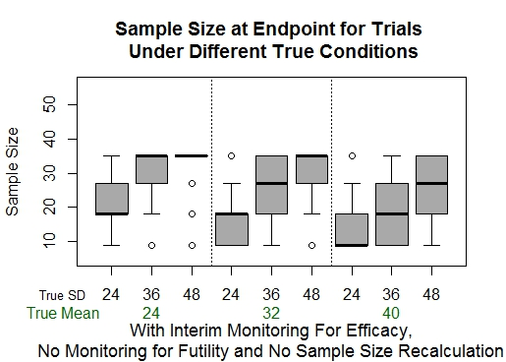
Effect of Interim Monitoring for Efficacy (Without Sample Size Re-estimation or Futility Monitoring)
Ending sample size < 35 per group because we can stop at earlier interim points when results are significant
Notes:
KP

Slide 13
Effects of Interim Monitoring for Futility (Without Sample Size Re-estimation)
Large drop in true Type I error from ~0.05 to ~0.01 (more opportunities to stop an ineffective trial from following through to the end and having significance by chance)
Smaller stopping point sample size when response variance is larger than expected
Chance of stopping early for futility, even if alternative is true, explains a slight drop in true power
Notes:
KP

Slide 14
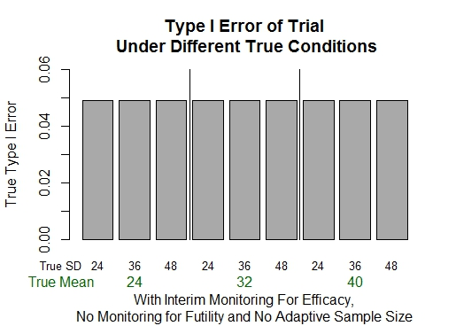
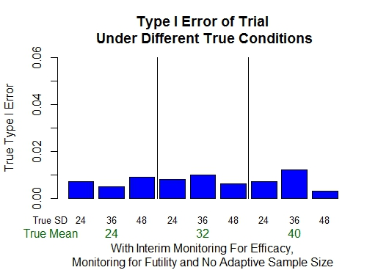
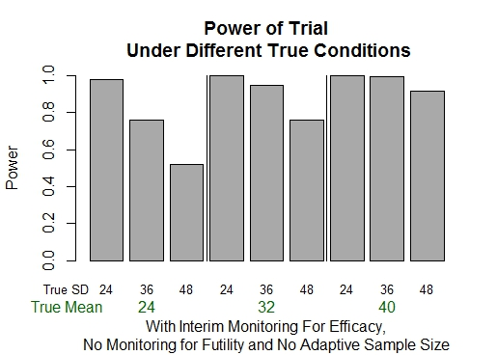
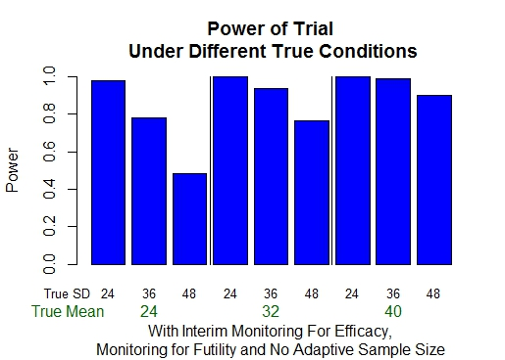
Effects of Interim Monitoring for Futility (Without Sample Size Re-estimation)

Slide 15
Notes:
KP

Slide 16
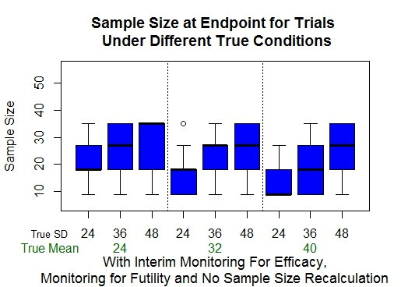
Notes:
KP

Slide 17
Effects of Sample Size Recalculation
If initial estimate of treatment response variance was too high, recalculation tends to decrease the ending sample size
Likewise, underestimated variance leads to a larger required sample size
Recalculation also maintains power of trial better even when initial estimate of variance is too low
Notes:
KP

Slide 18
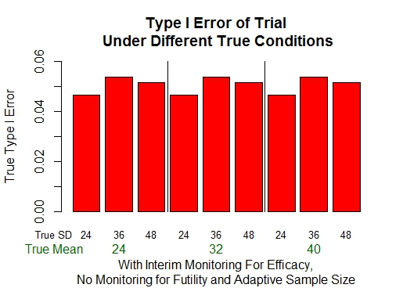
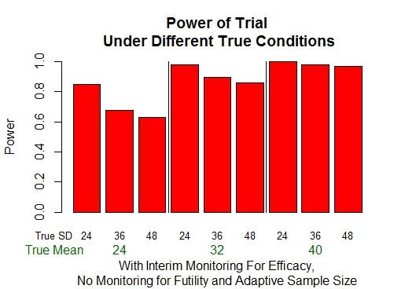
Effects of Sample Size Re-estimation (Without Futility Monitoring)

Slide 19
Notes:
KP

Slide 20
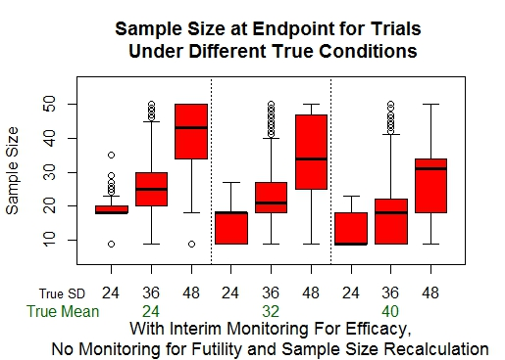

Slide 21
Overall Evaluation of Our Design
These characteristics show the design's potential value in Phase II trials:
Minimizes Type I error rate
Maintains power when variance estimate is too low
May decrease sample size required to reach a conclusion
Limitations:
Sample size re-estimation potentially increases cost
Notes:
HR
The effects of the design features that Kamrine described hint at our design's potential value in Phase II trials like the study motivating our project. futility monitoring tends to minimize type I error rate, while sample size reestimation helps to maintain the trials' power even if the initial estimate of variance is incorrect. All of these features also offer the possibility of reaching a conclusion sooner, which is especially important.
So far we have seen several limitations, however, to our design: re-estimation of sample size may increase sample size needed to reach a conclusion, which potentially increases costs, and the nature of all of these design features is to induce a positive bias in the estimated treatment effect. To get a better sense of the value of our trial design, however, we will compare a few example scenarios.

Slide 22
How Does Our Design Compare to
Interim Monitoring for Efficacy Alone?
If assumptions are accurate, with our design:
Median ending sample size is smaller
Power is slightly lower, but comparable
Type I error rate is lower (important for Phase 2 trials)
If assumptions are inaccurate (overestimated effect size and underestimated variance):
Ending sample size tends to be larger (more expensive)
Power is higher (though overall both are much lower)
Type I error rate is lower
Notes:
HR
So, with these ideas in mind we will compare our design--with efficacy and futility monitoring, as well as sample size reestimation--to a simple design with just interim monitoring for efficacy, and evaluate their performance when the initial design assumptions are correct, and when they are incorrect.
I will highlight a few points to look for, and then you'll see them graphically. When the assumptions are met, our design performs at least as well or better than the simpler method: ending sample size is often lower, power is comparable, and the Type I error rate is much lower.
When the assumptions are incorrect, however, our design also fares better in many respects. It maintains a somewhat higher power, and a lower type I error rate, though it tends to require a higher a larger sample size to reach a conclusion.

Slide 23
Notes:
HR
Here we have the results of the two designs, when the design assumptions of treatment effect and response variance are accurate.
Here we see that our design tends to stop earlier, with about half stopping by the second interim monitoring point, with lower type I error rate and only a slightly lower power.

Slide 24
O'Brien-Fleming Graphs
Notes:
HR
Now, we compare the designs in the case that the investigator makes incorrect estimates both of the effect and the response variance. This combination would be most detrimental to the outcome of the trial, because it means the trial is trying to detect an effect that is smaller than expected, but also less predictable than expected. In this case, our design adapts by tending to reestimate higher sample sizes, as shown on the left, which keeps the true power somewhat higher than the simpler design. Furthermore, the monitoring for futility keeps the type I error very low, which is valuable in this type of trial. Of course the limitation is that over half the trials have stopping points higher than the standard of 35, and at least a quarter reaching the absolute max of 50, but .

Slide 25
Conclusion:
"Is our design better for the motivating study?"
Yes!
Minimizing Type I errors is important in Phase II trials, which is achieved in our design
Treatment effect and response variance are not easily estimated in the motivating study
Our design's ability to maintain power and keep error rates low even with inaccurate design assumptions is beneficial
Limitation:
Potential for higher re-estimated sample size may increase cost of trial
Notes:
HR

Slide 26
Acknowledgements
The Iowa Summer Institute for Biostatistics program
Dr. Kathryn Chaloner and the entire University of Iowa Biostatistics department
My research partner Kamrine Poels at the University of Arizona
The Carleton Math Department

