Slide 1
Uniquely Bipancyclic Graphs
Zach Walsh

Slide 2
Research
REU at University of West Georgia
Advisor Dr. Abdollah Khodkar
Research partners Alex Peterson and Christina Wahl

Slide 3
Graphs
A graph G consists of a vertex set V(G) and an edge set E(G), where an edge is an unordered pair of vertices.
The order of a graph is the size of V(G).
If {A,B} is an edge, then we say A is adjacent to B.

Slide 4
Cycles
A cycle is a sequence of distinct adjacent vertices such that the first and last vertex in the sequence are the same.
A Hamiltonian cycle is a cycle that contains every vertex of the graph.
The length of a cycle is the number of unique vertices in the sequence.

Slide 5
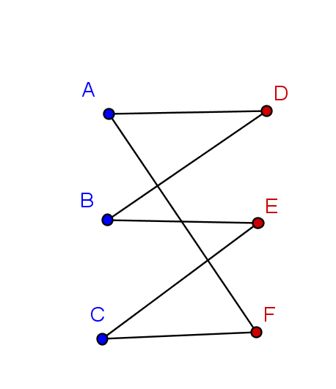
Bipartite Graphs
A graph is bipartite if its vertex set can be partitioned into two sets A and B such that every edge is incident to one vertex in A and one vertex in B.
A graph is bipartite if and only if it has no odd cycles.

Slide 6
Uniquely Bipancyclic Graph
A uniquely bipancyclic graph (UBG) of order n is a bipartite graph with exactly one cycle of length 2m for 2≤m≤n/2.
Exactly one cycle of length {4,6,8,10,…,n}

Slide 7
Special Properties of UBGs
Every UBG has a Hamiltonian cycle.
A chord is an edge incident to two nonadjacent vertices in a cycle.
If a UBG has C cycles, it has order 2C+2.

Slide 8
History
Pancyclic graphs
Bipancyclic graphs
Uniquely pancyclic graphs
Hamiltonian bipancyclic graphs
Uniquely bipancyclic graphs
Notes:
What are we thinking of doing here?

Slide 9
Previous Results
# of chords | # of UBG
0 | 1 (order 4)
1 | 1 (order 8)
2 | 4 (order 14)
3 | 6 (order 26)
Dr. Walter Wallis classified all UBG with three or fewer chords.

Slide 10
Methods
Break down the problem by number of chords.
Then for given number of chords, break down again based on number of chord crossings.
For k chords there are at most _{k}C₂ crossings.
For each crossing number we find all possible layouts.

Slide 11
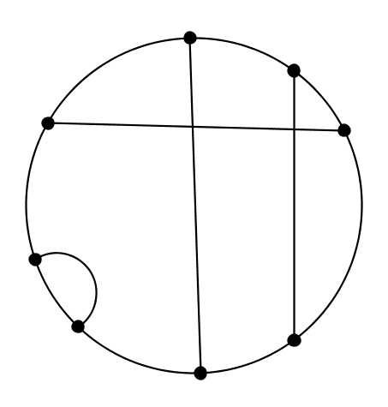
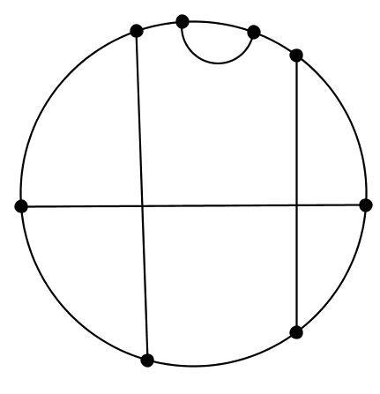
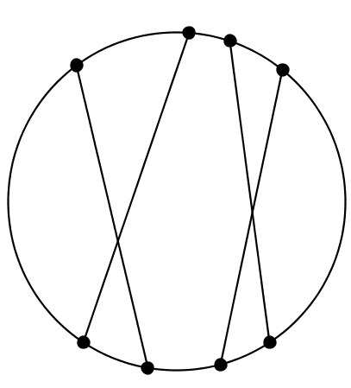
Four Chords, Two Crossings

Slide 12
Graph Labeling
For each layout we assign variables to the segments of the Hamiltonian cycle between chord endpoints.

Slide 13
Computing Cycle Lengths
We write down an equation for the length of each cycle in terms of the arc variables.
In this process we must ensure that we find all cycles.

Slide 14
Coding
Put the equations into an array.
Use nested loops to test all possible combinations of variable values.
If for some combination the array contains distinct even integers, we found a UBG.
for a in range(0,8):
for b in range(0,8):
check [a+1,b+1,a+b]

Slide 15
Main Result
# of chords | # of UBG
0 | 1 (order 4)
1 | 1 (order 8)
2 | 4 (order 14)
3 | 6 (order 26)
4 | 6 (order 44)
5 | 0
We classified all UBG with four or five chords.
We proved that there are exactly six UBG with four chords and none with five chords.

Slide 16
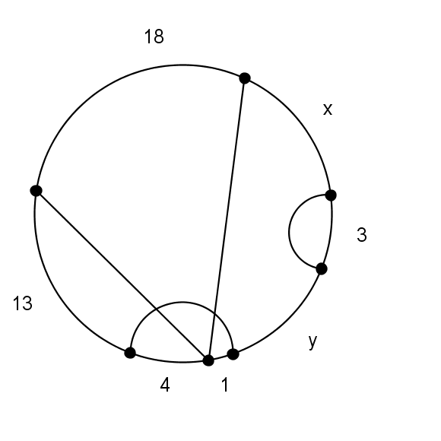
Order 44 UBG
The six order 44 UBG graphs have very similar structure.
Choose x and y such that x + y = 5.

Slide 17
Future Research
Are there infinitely many UBGs?
Are there any more UBGs?
For which integers n is there a UBG of order n?

Slide 18
Thank You!
NSF
Dr. Khodkar and UWG
Alex and Christina
NUMS

